Slide 1


THE BYTE-ENABLE MEMORY IMPLEMENTATION ON FPGA WITH VERILOG AND SYSTEM-VERILOG
Mid-Review 3
GITAM (Deemed-to-be) University
Major Project
Project ID: V7
AY 2021-25
Department of Electrical Electronics and Communication Engineering
Project Mentor:
Dr.Arun Kumar Manoharan
Project In-charge:
Dr.Arun Kumar Manoharan
Project Team:
Tammali Karthik (BU21EECE0100164)
Maria Punya (BU21EECE0100309)
www.gitam.edu

Slide 2
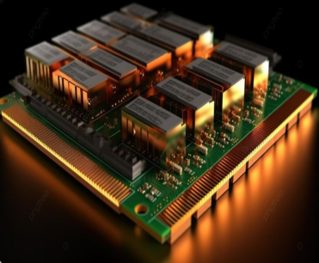
Abstract
This project focuses on the design and implementation of Byte-Enable Memory on FPGA to address the increasing need for efficient and flexible memory architectures in modern digital systems. Byte-Enable Memory allows for selective read/write operations at the byte level, enabling fine-grained data manipulation in applications like image processing and machine learning. This granularity enhances memory utilization by reducing write overhead and enabling precise control over data access. Verilog is used for architectural modelling, while System-Verilog facilitates the development of advanced test benches for comprehensive validation. Xilinx Vivado is employed for synthesis, simulation, and real-time testing, with a strong emphasis on optimizing resource utilization, maximizing performance, and minimizing power consumption.
The design incorporates byte-enable signals for each memory location, enabling precise control over which bytes are accessed during read and write operations. The project aims to deliver a high-performance and flexible Byte-Enable Memory solution tailored for demanding applications that require precise control over data manipulation at the byte level.
Fig:- Random Access Memory(RAM) Background

Slide 3
Objective and Goals
Objective
Optimize Resource Utilization - Efficiently utilize FPGA hardware resources to minimize usage while maintaining high performance.
Facilitate Comprehensive Verification - Develop SystemVerilog-driven test benches to validate the design under various conditions, ensuring robustness and reliability.
Enhance Memory Access and Scalability - Design and implement a byte-enable memory module to allow selective byte-level access and modifications, improving data integrity, performance, and scalability.
Goals
Main goals are:
Optimize Memory Usage and Performance – Enable selective byte-level access and modifications to improve efficiency, speed, and scalability.
Minimize Power Consumption – Reduce energy usage by accessing and modifying only the necessary bytes, enhancing resource efficiency.
Enhance Data Integrity and Reliability – Implement robust control mechanisms to ensure accurate, secure, and fault-tolerant operations.

Slide 4
Project Plan
Gant Chart - Milestones and Activities
SL.NO | Start Date | End Date | Description
1 | 28-Nov-2024 | 4-Dec-2024 | Continuation of analyzing the problem statement
2 | 7-Dec-2024 | 31-Dec-2024 | Working on the application of the project.
3 | 8-Jan-2025 | 10-Jan-2025 | Review-1
4 | 15-Jan-2025 | 30-Jan-2025 | Implementation in the FPGA kit.
5 | 05-Feb-2025 | 07-Feb-2025 | Review-2
6 | 10-Feb-2025 | 28-Feb-2025 | Writing of the conference paper.
7 | 15-March-2025 | 20-March-2025 | Review=3

Slide 5
Literature Survey
Key Publications
Advancing cryptographic security: a novel hybrid AES-RSA model with byte-level tokenization, Apr 16, 2024
Optimizing Systems for Byte-Addressable NVM by Reducing Bit Flipping, February, 2019.
20nm High-density single-port and dual-port SRAMa with worldline-voltage-adjustments system for read/write assists, 06 March 2014.
8-bit AES FPGA Implementation using Block RAM, 08 November 2007.
A 45-nm Single-port and Dual-port SRAM family with Robust Read/Write Stabilizing Circuitry under DVFS Environment., 01 August 2008.
Key Resources – Whitepaper| Application Notes | Datasheet| Others
Xilinx Vivado.
FPGA Kit
Existing Implementations – Products| Opensource| GitHub etc
Embedded Memory (RAM: 1-PORT, RAM: 2-PORT, ROM: 1-PORT, and ROM: 2-PORT) User Guide by Intel.

Slide 6
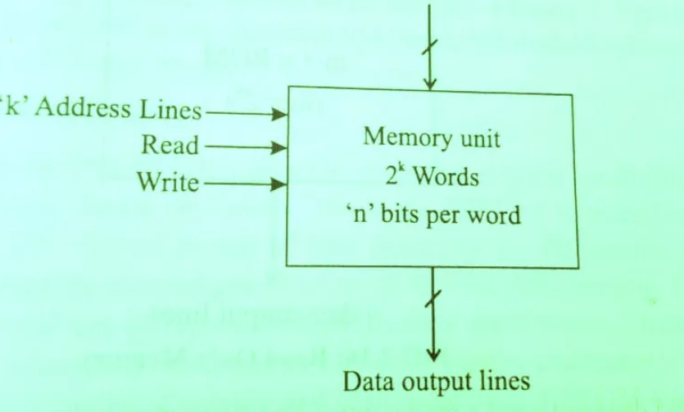
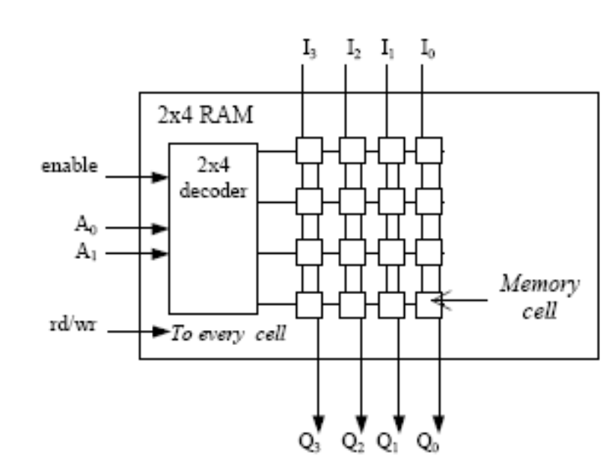
Implementation and Results – Iteration 1
1. RAM:
RAM (Random Access Memory) is a type of computer memory that is used to store data that is actively being used or processed by the CPU. It is a volatile memory, meaning it loses its contents when the power is turned off, making it temporary storage. RAM plays a critical role in the performance of a computer or any digital system by providing quick access to data and instructions needed by the CPU.
Block diagram of RAM
Logical diagram of RAM

Slide 7
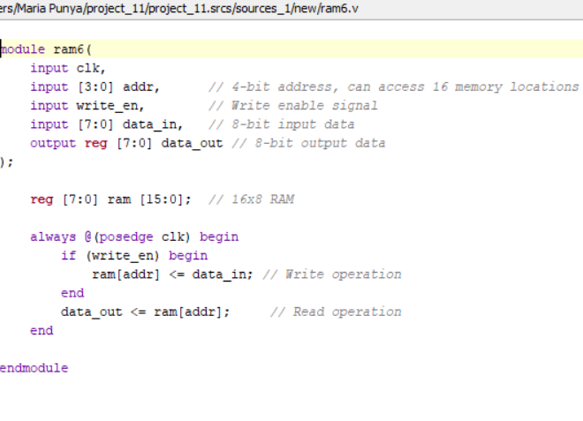
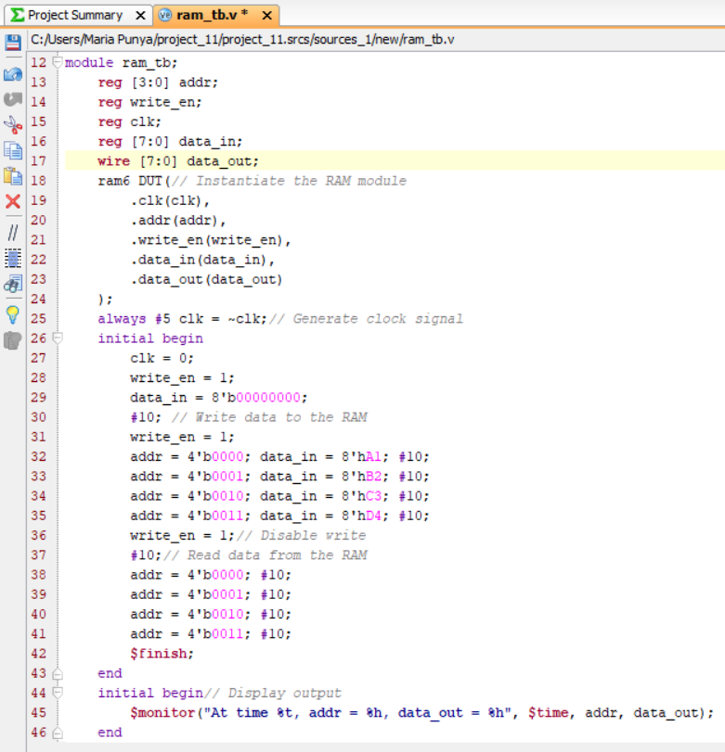
Verilog code for RAM:

Slide 8
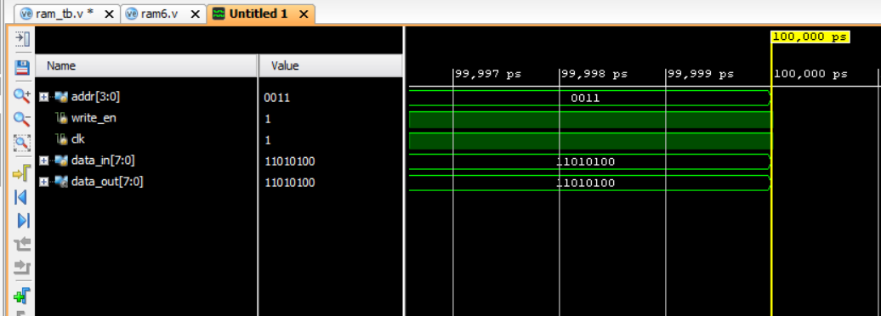
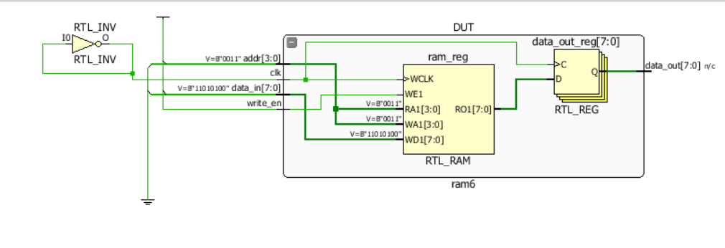
RESULTS:
Schematic Diagram:

Slide 9
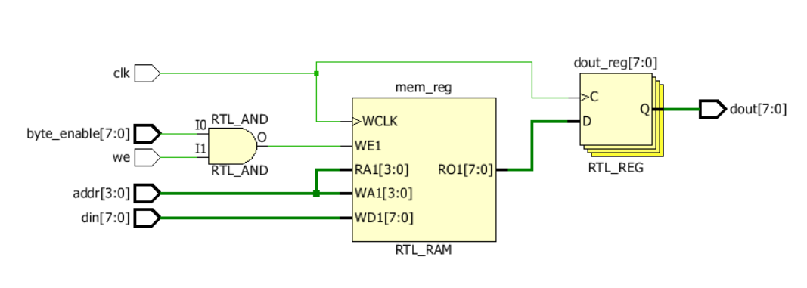
Implementation and Results – Iteration 2
Byte_Enable_RAM:
Byte-enable RAM allows you to selectively write or read individual bytes of a word. This means that even though the memory might store a full word (e.g., 8 bits), you can enable specific bytes (e.g., the lower or upper byte in a 16-bit word) and perform operations on those individually. This is especially useful when dealing with data that does not always need to be written or read completely, such as in certain hardware interfaces where you might need to update just one byte in a register.
Schematic Diagram:

Slide 10
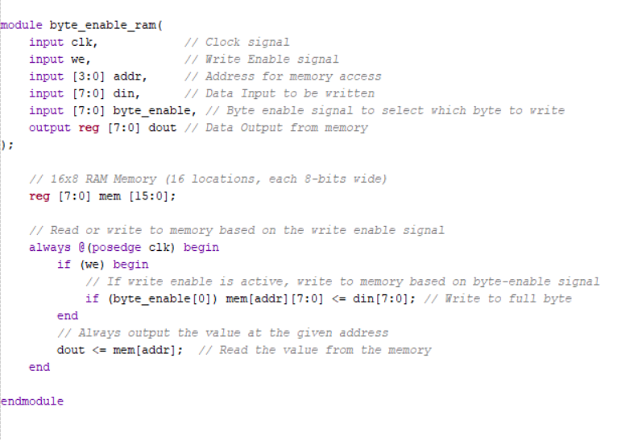
Verilog Code:

Slide 11
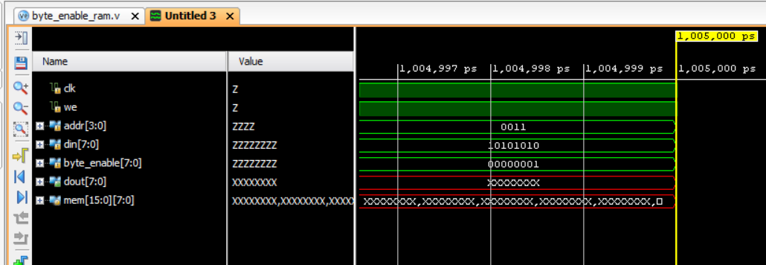
RESULTS
(Write operation) SET VALUES AS:
We[write] = 1
Addr[Address] = 3
din[data in] = 8'b10101010 byte_enable = 8'b00000001

Slide 12
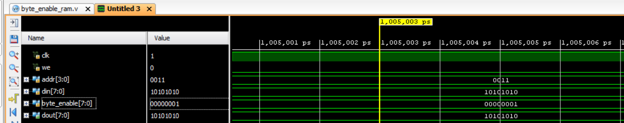
(Read operation) SET VALUES AS:
We[write] = 0
Addr[Address] = 3
din[data in] = 8'b10101010 byte_enable = 8'b00000001

Slide 13
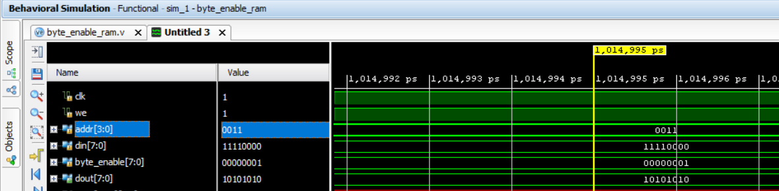
(WRITE operation) SET VALUES AS:
We[write] = 1
Addr[Address] = 3
din[data in] = 8'b11110000 byte_enable = 8'b00000001

Slide 14
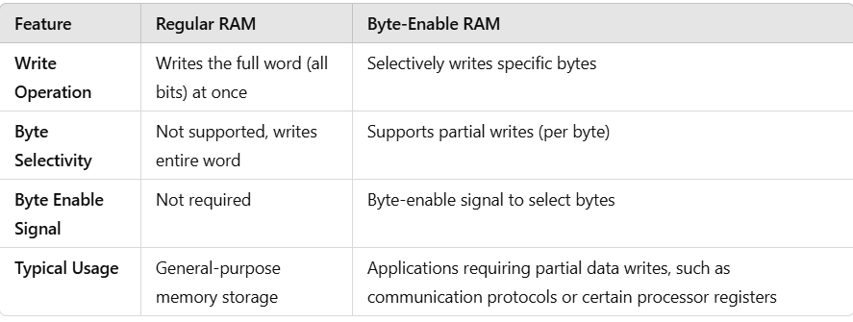
Key Differences:

Slide 15
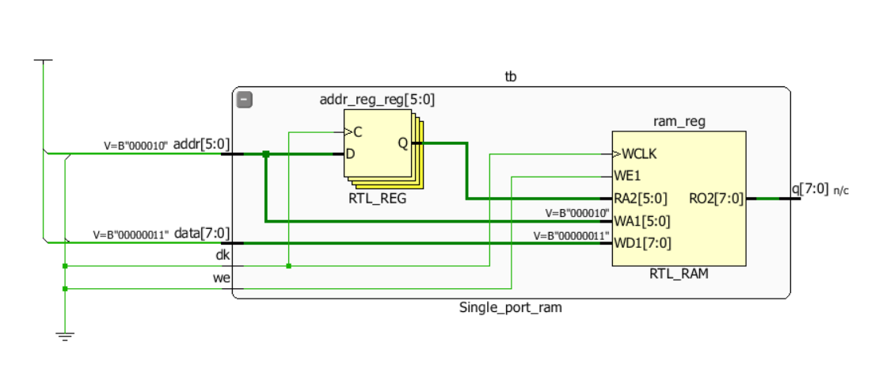
SINGLE PORT RAM
A single-port RAM (Random Access Memory) is a type of digital memory component that allows data to be read from and written to a single memory location (address) at a time. It is a simple form of memory that provides a basic storage mechanism for digital systems.
Block Diagram

Slide 16
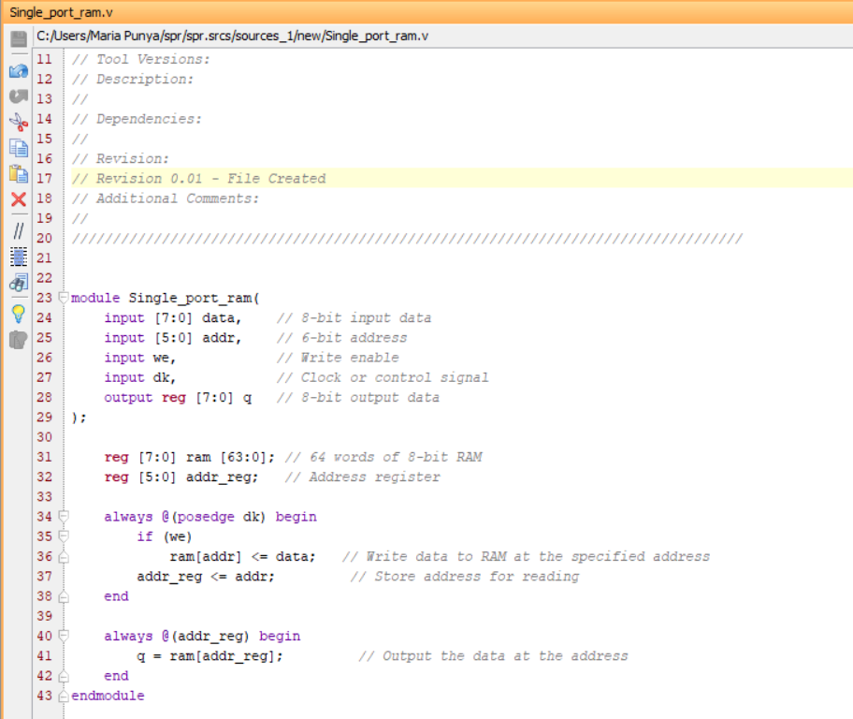
Verilog code for Single_Port_Ram

Slide 17
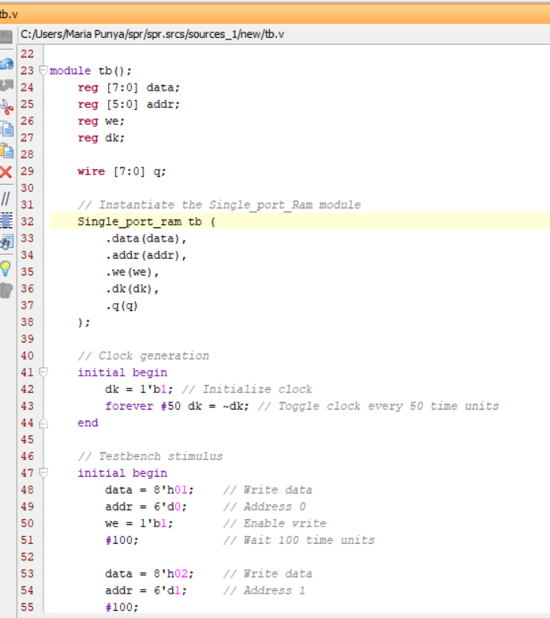
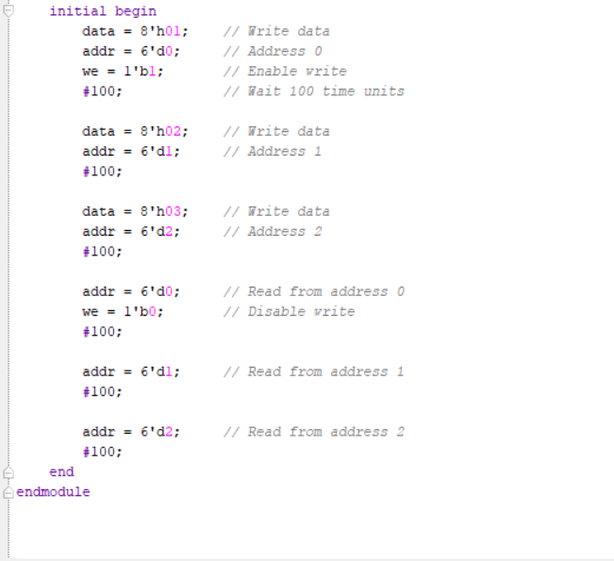
Testbench for Single_Port_Ram

Slide 18
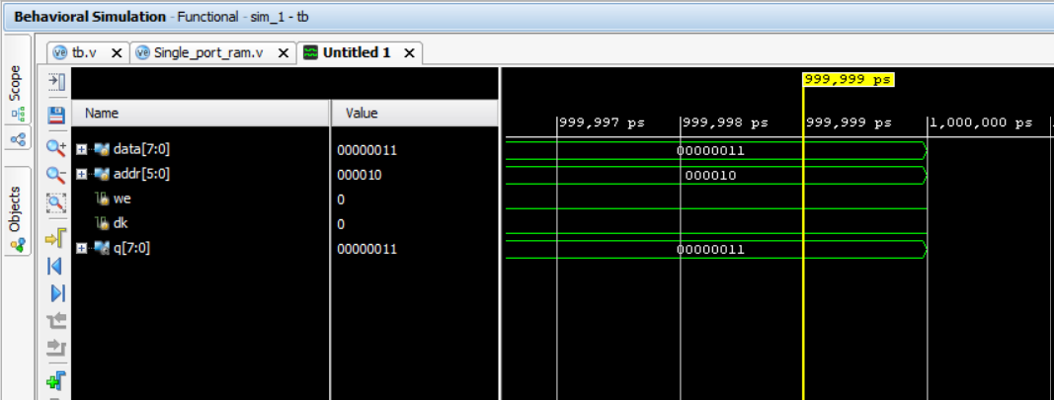
Result:

Slide 19
Difference Between Verilog & SystemVerilog
VERILOG | SystemVerilog
Hardware Description Language (HDL) used to model electronic systems. | Hardware Description and Hardware Verification Language used to model, design, simulate, test and implement electronic systems.
Supports structured paradigm. | Supports structured and object oriented paradigms.
Has the file extension .v or vh. | Has the file extension sv and .svh.
Influenced by C and Fortran. | Influenced by Verilog, VHDL and C++.
Supports Wire and Reg data types. | Supports various data types such as enum, struct, union, class and string.
Has a single always block to implement combinational and sequential logic. | Has always_comb, always_ff and always_latch procedural blocks
Based on hierarchy of modules. | Based on classes.
Uses module level testbench. | Uses class based testbench.

Slide 20
SYSTEM VERILOG
SystemVerilog is a hardware description and verification language that extends Verilog by adding modern features for both design and verification. It supports advanced constructs like object-oriented programming, interfaces, and assertions, making it ideal for designing complex digital systems and thoroughly testing them. Widely adopted in the semiconductor industry, it simplifies the creation of reliable and reusable designs, aligning with modern chip development standards.
Efficiency
Reusability Testbenches and modules can be reused in different projects.
Simplifies Complex Designs Suitable for designing processors, communication protocols, and advanced systems.
Future-Proof Keeps up with modern semiconductor trends and protocols like AXI, PCIe, etc.

Slide 21
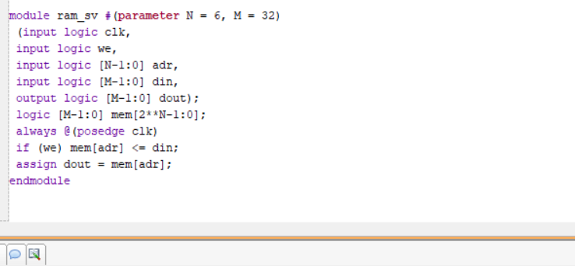
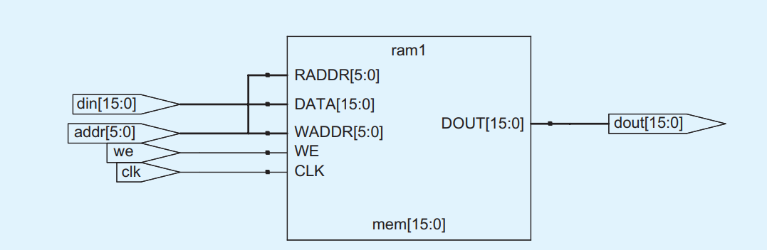
Implementation and Results – Iteration 3
3. Implementation of RAM in System Verilog.
Block diagram

Slide 22
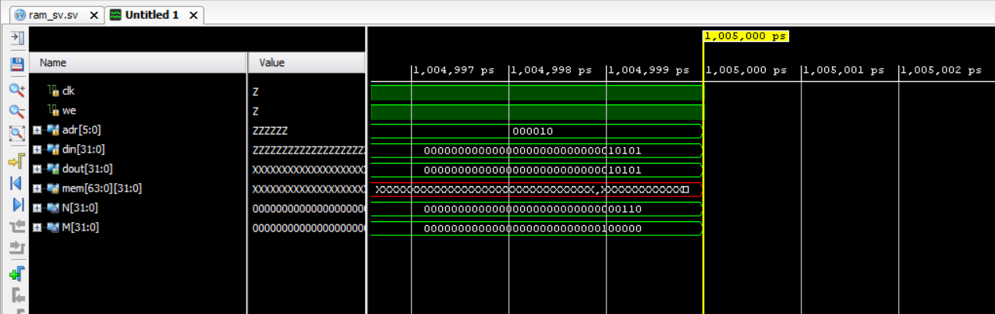
Results:

Slide 23
Use Cases & Testing
Test Cases:
Basic Read/Write Operations: Verify byte-level read/write operations and data integrity across different memory addresses with varying data widths and byte-enable signals.
Selective Byte Access: Ensure proper partial word modifications, validate masking, and verify enable signals during selective byte updates.
Simultaneous Operations: Test concurrent read and write operations for data consistency and conflict resolution at the same or different addresses.
Boundary and Error Handling: Validate handling of address overflows, invalid byte enables, and fault detection mechanisms, ensuring proper error handling and system response.
Use Cases:
Embedded Systems and IoT Devices – Suitable for efficient memory management in systems requiring byte-level data manipulation and real-time processing.
Digital Signal Processing (DSP) Applications – Supports high-performance data buffering and streaming operations, enabling selective data access for processing tasks.
FPGA-Based Prototyping – Provides a scalable and reusable memory design optimized for FPGA-based testing, prototyping, and implementation in diverse applications.

Slide 24
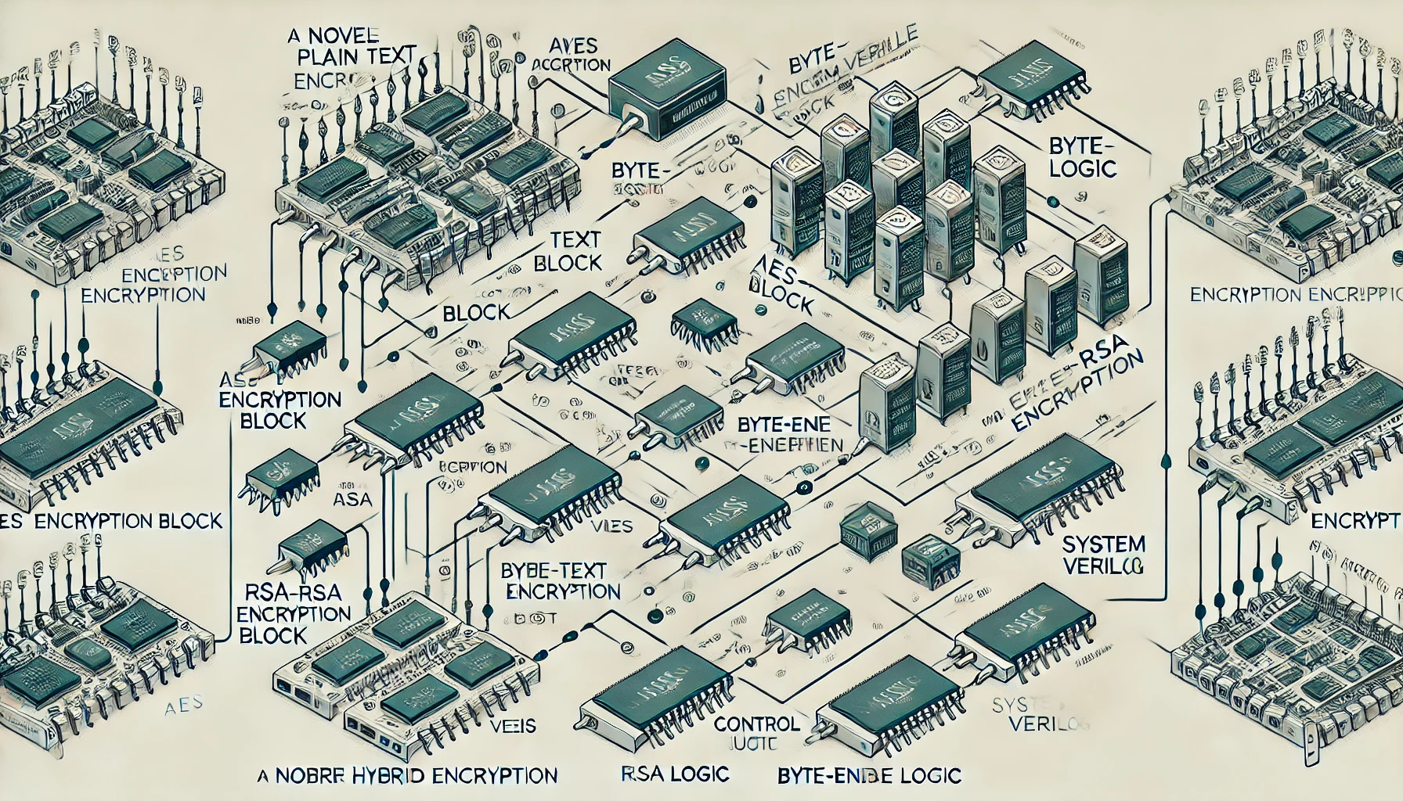
Application
Benefits to the Society
1. Advancing cryptographic security: a novel hybrid AES-RSA model with byte-level tokenization.
Designing a hybrid AES-RSA model with byte-level tokenization involves integrating both Advanced Encryption Standard (AES) and Rivest–Shamir–Adleman (RSA) cryptographic techniques. The following steps outline the workflow for this security model, including descriptions, flowcharts, and block diagrams.

Slide 25
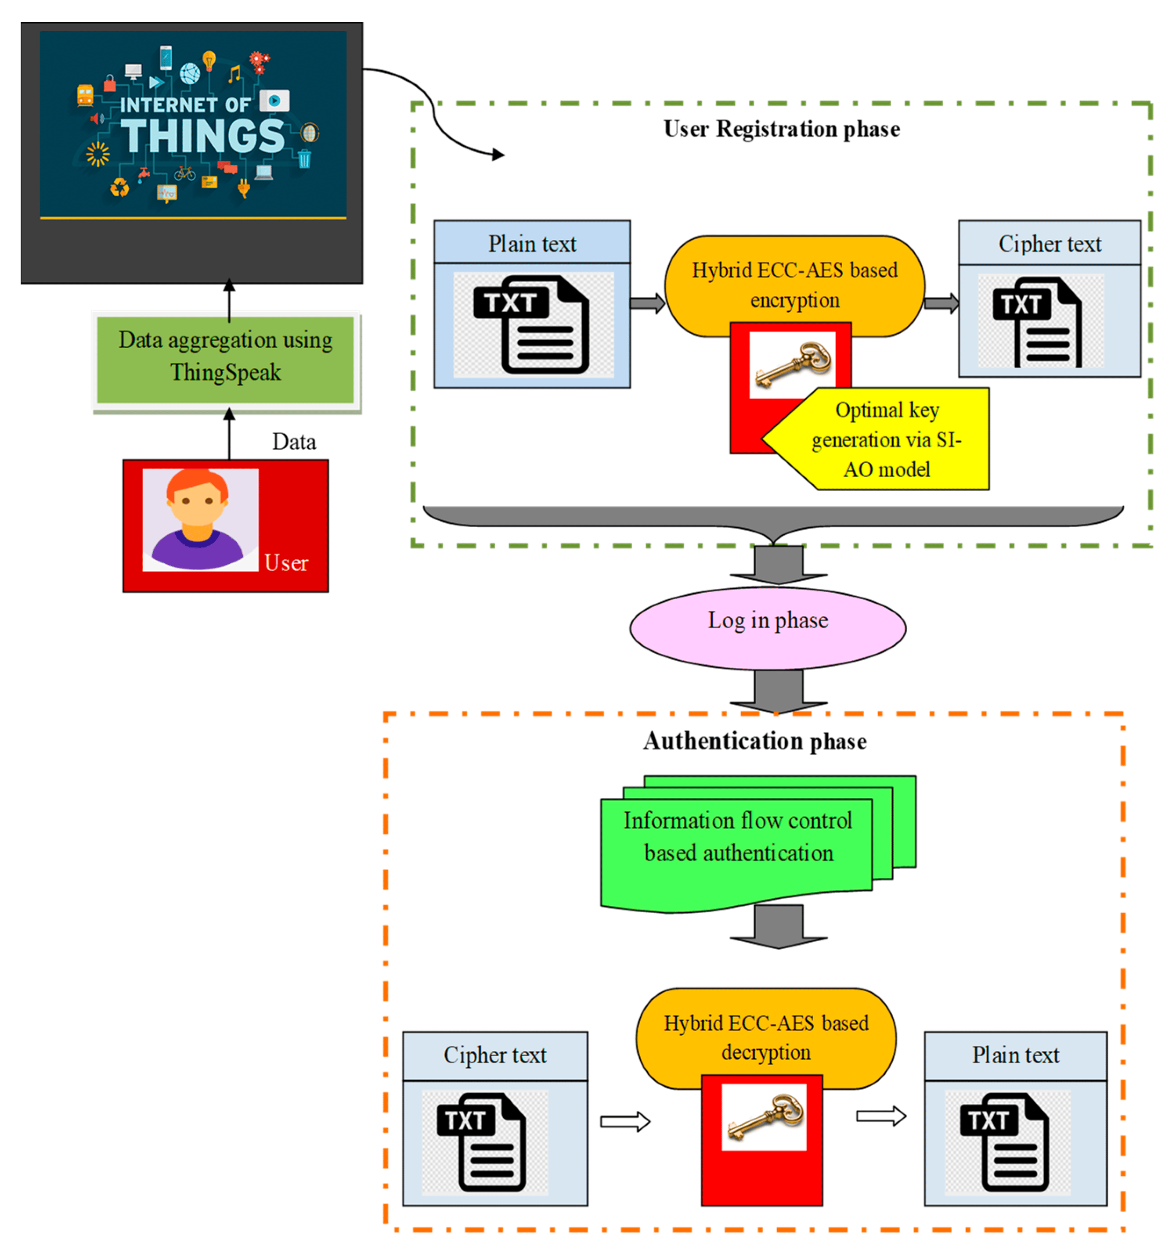
Advantages :
Protection from Sophisticated Cyberattacks: As cyberattacks grow more complex,
this multi-layered encryption approach can defend against these advanced threats, ensuring that sensitive data remains safe from unauthorized access.
Improved Data Integrity and Confidentiality: By combining multiple encryption techniques,
it offers stronger protection against data breaches, which is crucial for maintaining privacy in both personal and professional settings.
Enhanced Communication Security: In industries such as finance, healthcare,
and e-commerce, where data security is critical, this method could enhance secure communication and transactions, reducing the risk of cybercrimes.

Slide 26

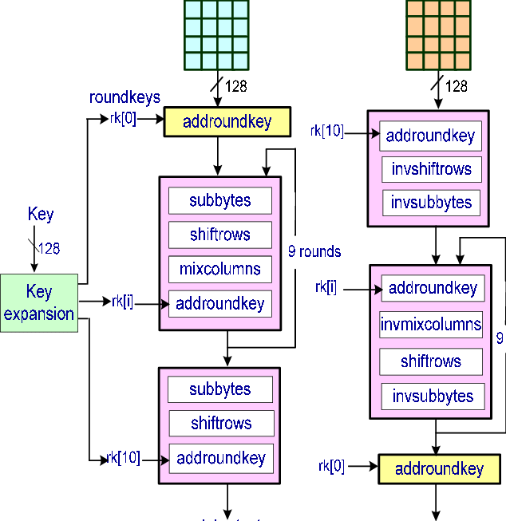
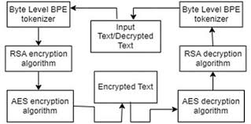
PROJECT FLOW
Hybrid AES-RSA
Data Transmission/Storage
Data Input
Data Decryption
AES Encryption
RSA Decryption (decrypts AES key)
Fig:- File Encryption/Decryption process
Byte-Level Tokenization
Byte-Level De-Tokenization
AES Decryption
RSA Encryption
(for AES key encryption)
Data Output
Fig:- Byte-Level Tokenization flow

Slide 27
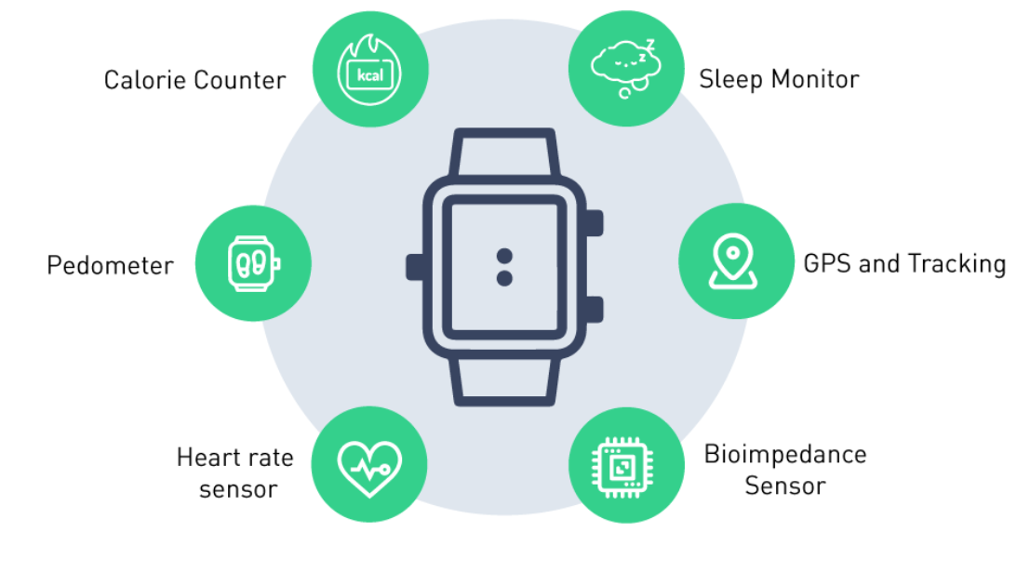



Medical Devices That Benefit from Byte-Enable RAM
1, Wearable Health Monitoring Devices
2. Smartwatches & Fitness Trackers (Apple Watch, Fitbit, etc.)
3. Wearable ECG & Heart Rate Monitors (e.g., Holter monitors)
4. Continuous Glucose Monitors (CGMs) for diabetic patients

Slide 28
Consider a fitness tracker storing sensor data in a 32-bit word (4 bytes):
Case 1: Normal RAM (Inefficient)
If the Battery Level (Byte 0) changes, normal RAM writes the entire 32-bit word again, even though only one byte changed.
Wastes power and memory bandwidth.
Case 2: Byte-Enable RAM (Efficient)
Only Byte 0 (Battery Level) is updated, while the rest remain unchanged.
Saves power, reduces latency, and improves efficiency.

Slide 29

Advantages :
Byte-Enable RAM: Why It’s More Efficient
Byte-Enable RAM includes extra control signals that allow updates to only the necessary bytes.
Instead of rewriting all 4 bytes, only Byte 0 (Battery Level) is updated.
Other bytes (Heart Rate, Step Count, Temperature) remain unchanged in memory.
Example (Byte-Enable RAM Write Process)
If Battery Level (Byte 0) drops from 80% to 75%,
Only Byte 0 is written, while Bytes 1, 2, and 3 remain untouched.
✅ Saves power ✅ Reduces memory bandwidth usage ✅ Improves system efficiency

Slide 30
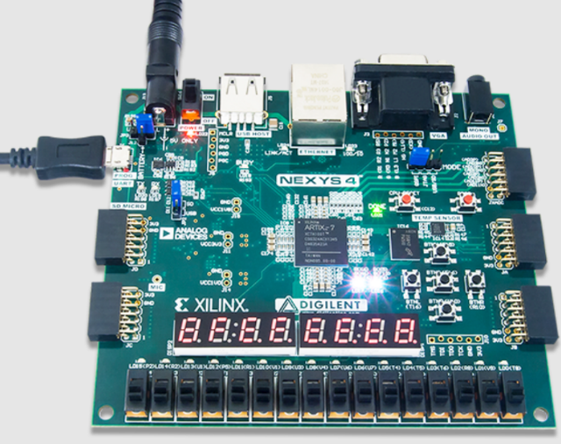
Implementation of Byte_Enable_RAM in the FPGA.
In this project FPGA Kit has a central role in the implementation of the byte_enable_ram working. By facilitating individual byte lanes, byte enable allows only relevant parts of the memory to be updated, leading to increased performance and power savings. In a standard deployment, a word of memory (e.g., 32-bit) is partitioned
into several bytes, and each is driven by a respective byte enable signal. When a write operation occurs, only the bytes with an active enable signal are modified, while the others remain unchanged. This approach is widely used in FPGA-based designs for optimizing memory access and improving system responsiveness, especially in applications like FIFO buffers, data storage, and partial updates in processing pipelines.
When a write operation occurs, only the bytes with an active enable signal are changed, while the others remain unchanged. This approach is widely used in FPGA-based designs for optimizing memory access and improving system responsiveness, especially in applications like data storage, and partial updates in processing pipelines.
Fig. 1. Artix-7 FPGA Nexys 4

Slide 31
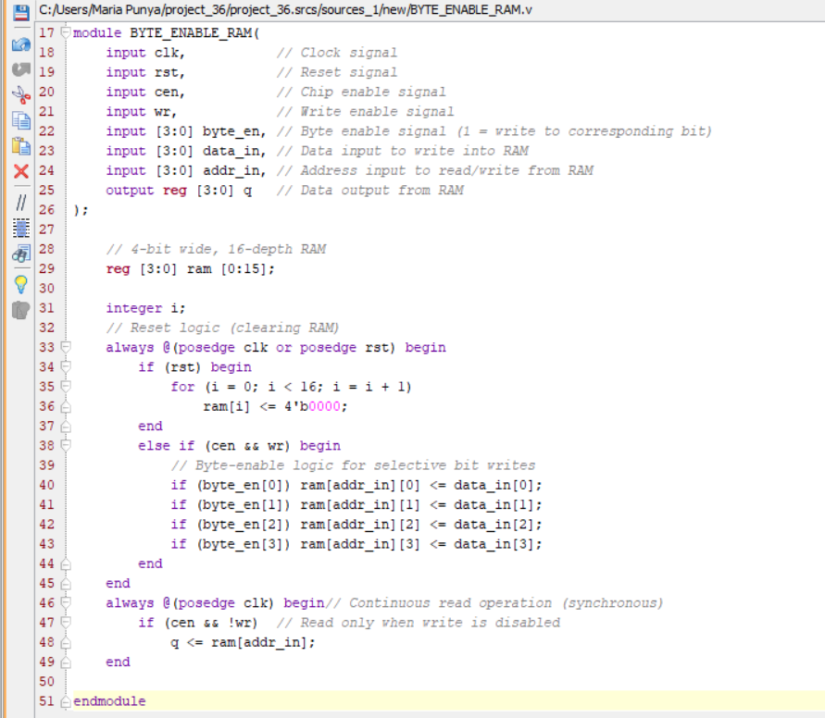
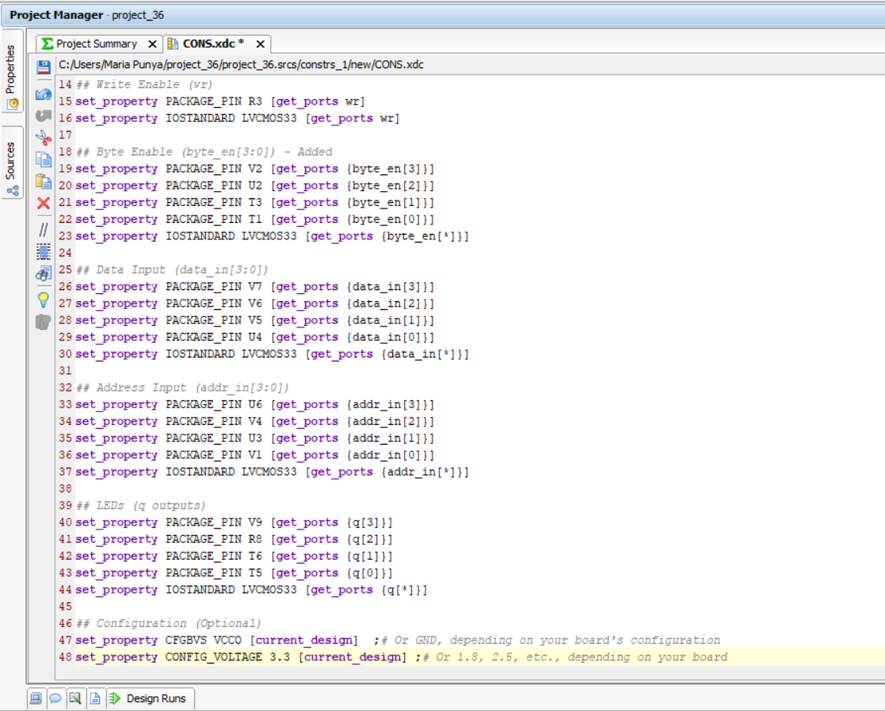
Verilog code for Byte_Enable_RAM.
Constraints File for Byte_Enable_RAM.

Slide 32
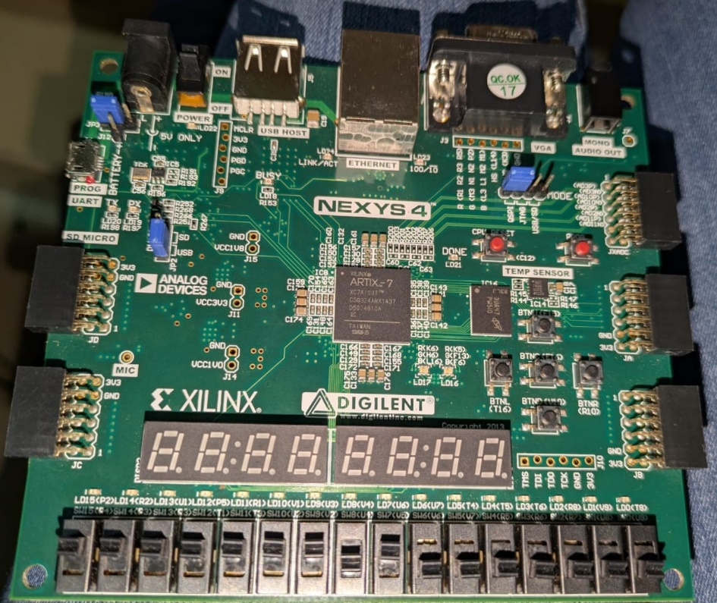
Pin Assignment in the FPGA kit.
P4 cen
P3 rst
R3 wr
V2, U2, T3, T1 byte_en[3:0]
V7, V6, V5, U4 data_in[3:0]
V9, R8, T6, T5 q[3:0]output

Slide 33
Table 1.Assignment of pin in the FPGA kit.
Signal | Pin | Function
clk | E3 | Clock input (10 MHz)
rst | P3 | Reset input (active high)
cen | P4 | Chip enable (RAM activation)
wr | R3 | Write enable (1 = Write, 0 = Read)
byte_en[3:0] | V2, U2, T3, T1 | Byte-enable bits for selective writing
data_in[3:0] | V7, V6, V5, U4 | 4-bit Data input
addr_in[3:0] | U6, V4, U3, V1
4-bit Address input
q[3:0] | V9, R8, T6, T5 | 4-bit RAM output (LED display)

Slide 34
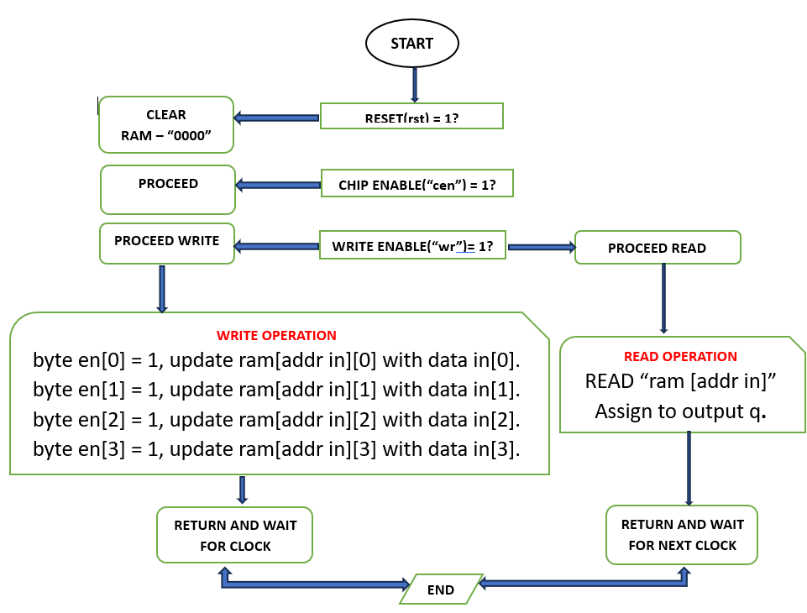
Workflow of the BYTE_ENABLE_RAM
The workflow of the Byte_Enable_RAM is shown in the Fig 3.
Sequence of steps
Step 1: Check Reset (rst)
If rst = 1, clear every memory locations (RAM[0] to RAM[15]) to 0000.
If rst = 0, proceed to original operation.
Step 2: Check Chip Enable (cen)
If cen = 0, if there is no operation (read/write) is performed.
If cen = 1, proceed to the next step.
Step 3: Determine Read or Write Mode (wr)
If wr = 1, enter write mode (Step 4).
If wr = 0, enter read mode (Step 5).
Step 4: Write Operation (if wr = 1)
Check each bit of byte_en:
If byte_en[0] = 1, update ram[addr_in][0] with data_in[0].
If byte_en[1] = 1, update ram[addr_in][1] with data_in[1].
If byte_en[2] = 1, update ram[addr_in][2] with data_in[2].
If byte_en[3] = 1, update ram[addr_in][3] with data_in[3].
Any bit where byte_en[i] = 0 remains unchanged.
Step 5: Read Operation (if wr = 0)
Read the data stored at ram[addr_in] and assign it to output q.
Step 6: Wait for Next Clock Cycle
The process repeats on every clock cycle.

Slide 35
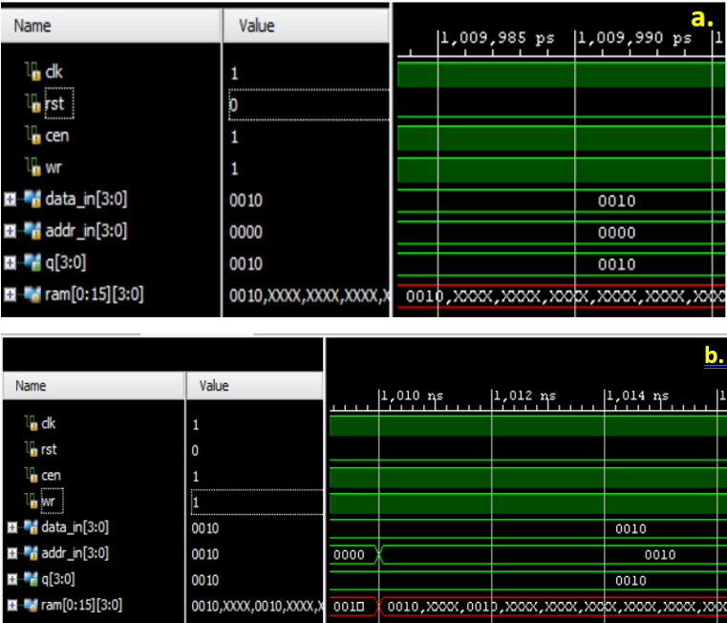
RESULTS AND DISCUSSION
(a.) when Clk=1 and Write =1,Cen=1 and rst=0 then the data_in=0010 is in written in the Ram in the assigned location addr_in=0000
(b.) Write Operation in different address location.
when Clk=1 and Write =1,Cen=1 and rst=0 then the data_in=0010 is in written in the Ram in the assigned location addr_in=0010[1].
Fig. Write operation byte enable RAM.

Slide 36
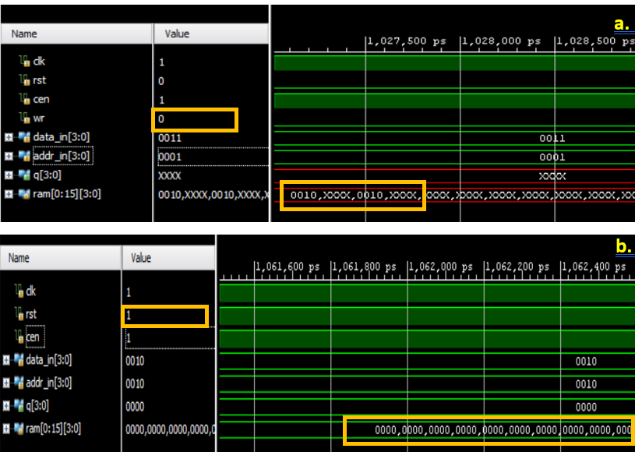
(a.) Read Operation.
when Clk=1 and Write =0,Cen=1 and rst=0 then the data_in=0011 is read by the Ram and remain unchanged at assigned location addr_in=0001.As shown in the above Fig 6.
(b.) Reset Operation.
when Clk=1 and Write =1,Cen=1 and rst=1 then the data_in=0010 is in written in the Ram in the assigned location addr_in=0010[1]. All the data_in in the Ram becomes ‘0000’. As shown in the above Fig 6.
Fig .Read and Reset Operation Byte_Enable_RAM.

Slide 37
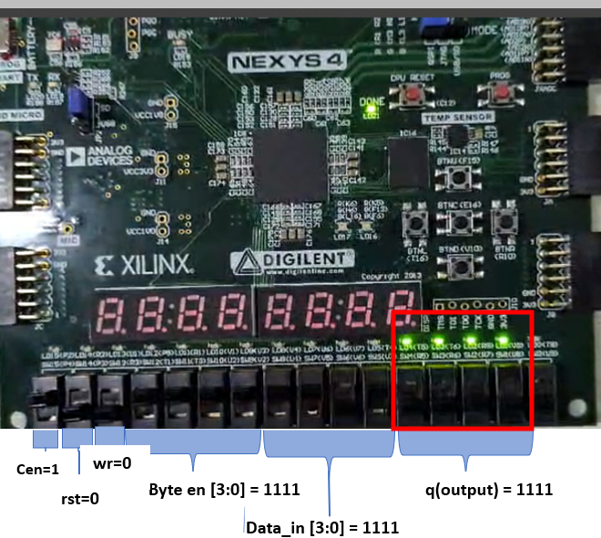
FPGA IMPLEMENTATION RESULTS.
Step 1: Check Reset (rst)
If rst =1, clear all memory locations (ram[0] to ram[15]) to 0000.
Set rst = 0, proceed to normal operation.
Step 2: Check Chip Enable (cen)
If cen = 1.
Step 3: Determine Read or Write Mode (wr)
If wr = 1, enter write mode (Step 4).
Step 4: Write Operation (if wr = 1)
Check each bit of byte_en:
If byte_en[0] = 1, update ram[addr_in][0] with data_in[0].
If byte_en[1] = 1, update ram[addr_in][1] with data_in[1].
If byte_en[2] = 1, update ram[addr_in][2] with data_in[2].
If byte_en[3] = 1, update ram[addr_in][3] with data_in[3].
Any bit where byte_en[i] = 0 remains unchanged.
Step 5: Wait for Next Clock Cycle
The process repeats on every clock cycle.
Fig. FPGA Implementation of Write Operation.

Slide 38
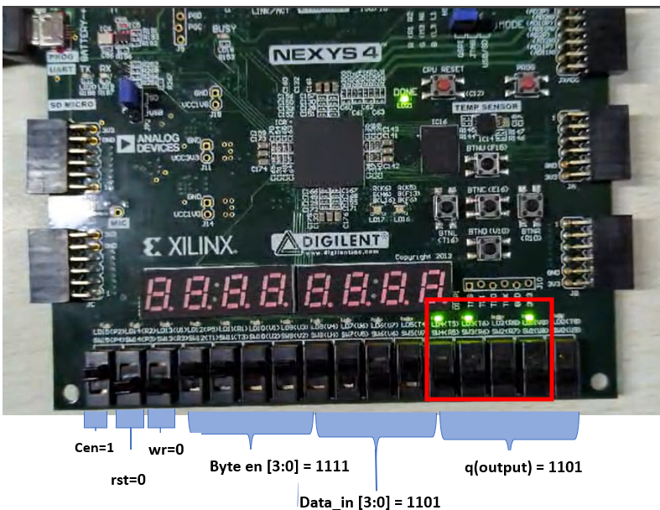
Step 1: Check Reset (rst)
If rst = 0, proceed to normal operation.
Step 2: Check Chip Enable (cen)
If cen = 1, proceed to the next step.
Step 3: Determine Read or Write Mode (wr)
If wr = 0, enter read mode (Step 5).
Step 4: Write Operation (if wr = 1)
Check each bit of byte_en:
If byte_en[0] = 1, update ram[addr_in][0] with data_in[0].
If byte_en[1] = 1, update ram[addr_in][1] with data_in[1].
If byte_en[2] = 0, update ram[addr_in][2] with data_in[2].
If byte_en[3] = 1, update ram[addr_in][3] with data_in[3].
Any bit where byte_en[i] = 0 remains unchanged.
Step 5: Read Operation (if wr = 0)
Read the data stored at ram[addr_in] and assign it to output q.
Step 6: Wait for Next Clock Cycle
The process repeats on every clock cycle.
As shown in the given above Fig 6.2. The pin E3(clk), P4(cen), R3(wr), and V2,U2,T3,T1(byte_en[3:0]) are enabledpins.The data_in(V7,V6,V5,U4) are given 1111. The output pin q[3:0] (V9,R8,T6,T5) leds ar+e glowing showing the required output.We can access each bit separately according to the requirement of the application.
Implemention of Byte_Enable_RAM in FPGA is shown in the Fig
Fig 9. FPGA implementation of selection a bit.

Slide 39
Conference Paper Submission
Sl. No | Name of the Conference | Paper ID | Status
01 | 2025 INTERNATIONAL CONFERENCE ON ADVANCEMENT IN COMMUNICATION AND COMPUTING TECHNOLOGY | 1762 | Submitted
02 | 5TH INTERNATIONAL CONFERENCE FOR INTELLIGENT TECHNOLOGIES. | 1214 | Submitted
03 | INTERNATIONAL CONFERENCE ON ELECTRONICS, AI AND COMPUTING. | 600 | Submitted

Slide 40
Conclusion & Future Work
Summary and Conclusion
A byte-enable memory architecture enabling selective byte-level access and modifications, optimizing memory usage, enhancing performance, and supporting parallel processing applications.
Verilog testbenches were utilized for functional verification.
The design was synthesized and implemented on an FPGA to validate its functionality, ensuring proper timing, area, and power optimization.
Test cases included boundary condition checks, simultaneous read-write operations, and fault injections.
Conclusion:
The project successfully implemented a reliable and efficient BYTE ENABLE RAM on FPGA.
Verilog-driven results ensured the design met functional and performance requirements.
Future Work:
Our project focuses on SystemVerilog implementation.
We aim to utilize advanced implementation features for design and verification.
Future work will explore enhanced methodologies and tools within SystemVerilog.

Slide 41
Contribution
Team Progress and Movement
Completed Implementatiuon Of RAM,Single Port RAM Byte_Enable_RAM on FPGA.
Conference paper has been submitted.
Working on creating a effective memory application
Individual Contribution
Key contributions: Maria Punya
Implementation on FPGA
Documentation
Key contributions: Tammali Karthik
Documentation
Implementation.
Application oriented research.

Slide 42
THANK YOU
Have a Great Day !

